Slide 1
Episode I: The Phantom Menace
Ezra Davis, Walt Gallati, Margvelashvili Vakhtang, Yihong Zhou

Slide 2
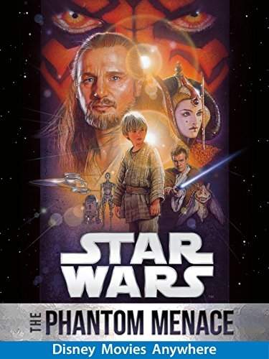
Overview
Summary
Technologies
Effects on Filmography
Conclusions
Redundancy
Artificial Intelligence
[1]
Notes:
Summary plot of the movie
List of Information technologies
The effects that star wars the phantom menace had on filmography
Finally we are going to explain the conclusion

Slide 3
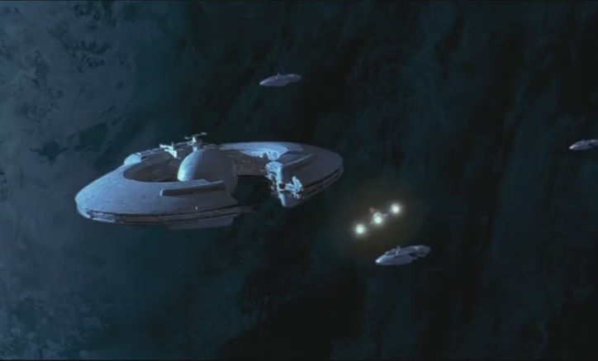
Summary of the movie
Blockade of Naboo.
Jedi rescue Queen Amidala
Arrive at Tatooine, meet Anakin
Anakin wins pod race and freedom.
Qui-Gon finds strong force in Anakin.
Arrival at Coruscant
Padme cannot get diplomatic assistance
Anakin is banned from being trained by Qui-Gon
Return to Naboo.
Final battle.
Anakin destroys droid ship.
[1]
Notes:
Blockade of Naboo by Trade Federation
Jedi sent to intervene are almost killed, escape with Princess Padme
Arrive at Tatooine, meet Anakin
Anakin wins pod race and freedom; revealed to be strong in the force
Jedi, Anakin, and Padme arrive at Coruscant - Padme cannot get diplomatic assistance, Anakin is banned from being trained by Qui-Gon
Party returns to Naboo to fight Trade Federation
Anakin destroys droid ship and saves the day

Slide 4
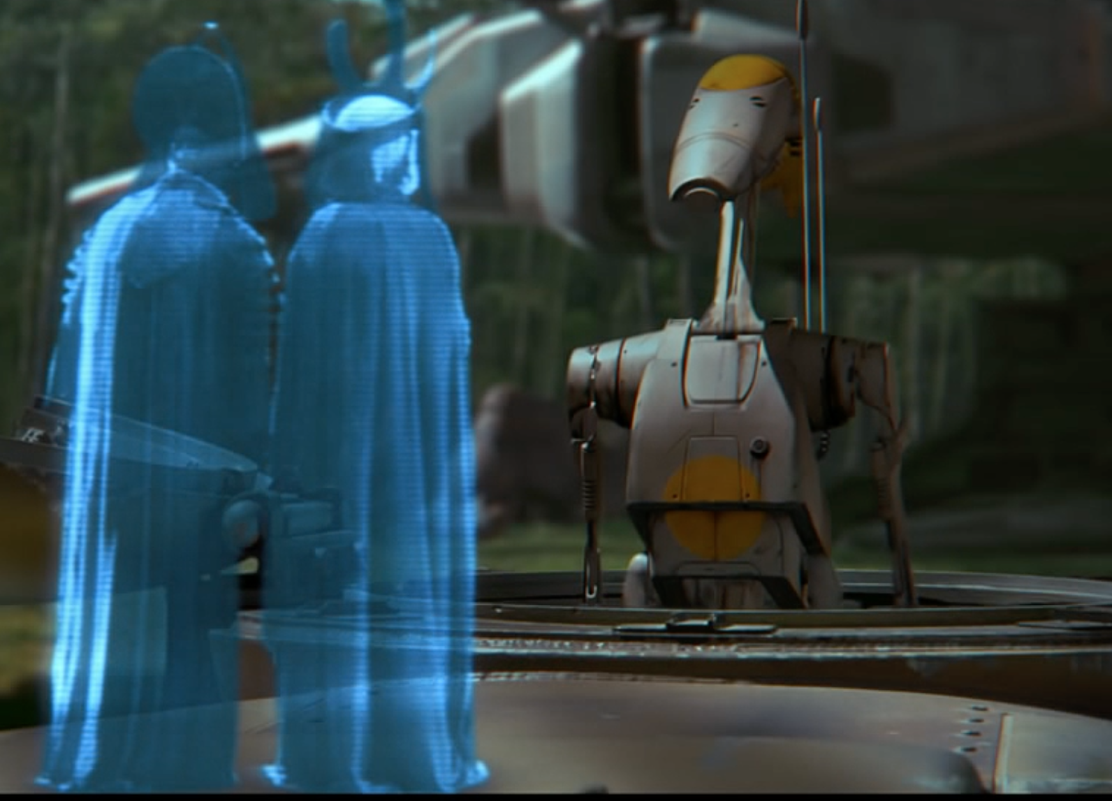
List of information technologies
3D display in air (created in 2011) [2]
Handheld 2 way radio (1923 Police radio, 1940 Hand Talkie) [3][4]
Republic Credits are cryptocurrency, akin to BitCoin (2009) [5]
Touchscreen tablets (Apple Newton 1993) [6]
Slave transmitter implants (Pacemaker 1958)[7]
Rear view camera (Law 2007)[8]
Robots
Faster-than-light communication
Large data transfer capabilities
Traceable from transmitter and receiver
Highly reliable
Jammable
No recording technology
[1]
Notes:
Picture from 0:10:32
• There’s a lot of information technologies used in The Phantom Menace.
• One of the more common pieces of technology are these monochromatic holograms used for communication. Real versions of these have been developed (and published about in Siggraph) - they work by ionizing the air with lasers.
• The Naboo forces also use Walkie Talkies in the movie, which were used extensively as far back as WWII and used even before that, for example Police in Victoria Australia used two way radios in cars as early as 1923
• There’s also tablets in the movie that stream a live sports event.
• All of the slaves in Tatooine are given an implant that will kill them if they try to escape. Implanted pacemakers have existed since 1958 (Arne Larsson, Swedish), even though that one lasted only 8 hours. Theoretically, a pacemaker fitted with an antenna could be used as a slave implant.
• More positively, one of the pod-racers uses a rear-view camera, which predicted that a law would be passed in the US in 2007 requiring cars to have one.
• We have nowhere near the level of technology used in the droids in the movie - they talk to communicate, walk on two legs (which is the subject of ongoing research here at WPI), and have a sense of self.
• There’s also extensive use of faster than light technology, (describe capabilities on slide), which we currently don’t believe to be possible.
• Oddly, when the Galactic Senate asks Queen Amidala to produce evidence of the blockade, she is unable to, possibly because there doesn’t appear to be a real internet or undoctorable recording technology.

Slide 5
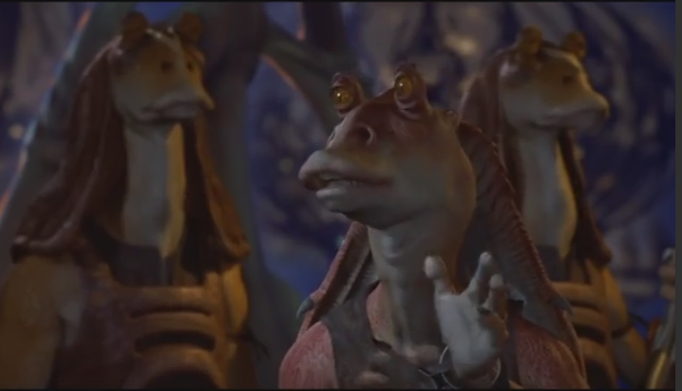
Phantom Menace Paved way for Digital Filmography
Jar Jar Binks was fully computer generated. [9]
Had more visual effects done in post processing. [9]
First movie projected to the public with digital projectors. [10]
Some scenes were filmed digitally. [11]
[1]
Notes:
On of the major characters were fully computer generated (but used Mocap)
Had lots of effects done in post processing, like extracting actors from one cut and putting them into another, crowd scenes of the droid army. Pod racer landscape completely computer generated.
It was also the first move that was shown to the public with fully digital projection in 4 theaters.

Slide 6
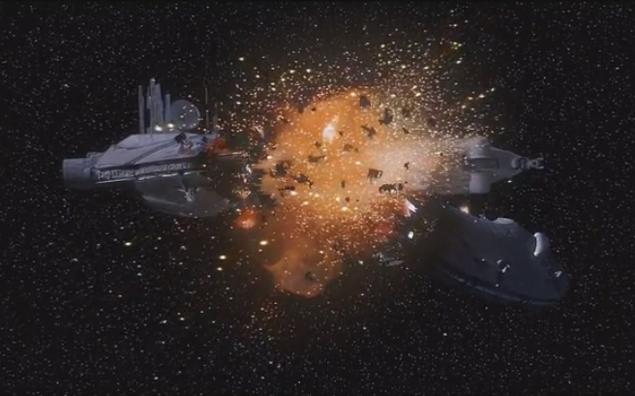
Redundancy is the difference between failure and success
Destruction of single droid ship causes all droids to shut down
Anakin wins pod race because of redundant systems
Naboo ship runs the blockade because of redundant Astromech droids
[1]
Notes:
We are going to talk about first conclusion about the redundancy.
First, Destruction of single droid ship causes all droids to shut down.This is a terrible failure because of the redundancy. Losing the central control of the space ship, the whole invasion plan of the trade federal was destroyed.
He used the redundant system as a backup to prevent system from failure, although his antagonist try to sabotage his work, Anakin finally win the game. This is a successful example for preventing error and risk.
Finally,

Slide 7
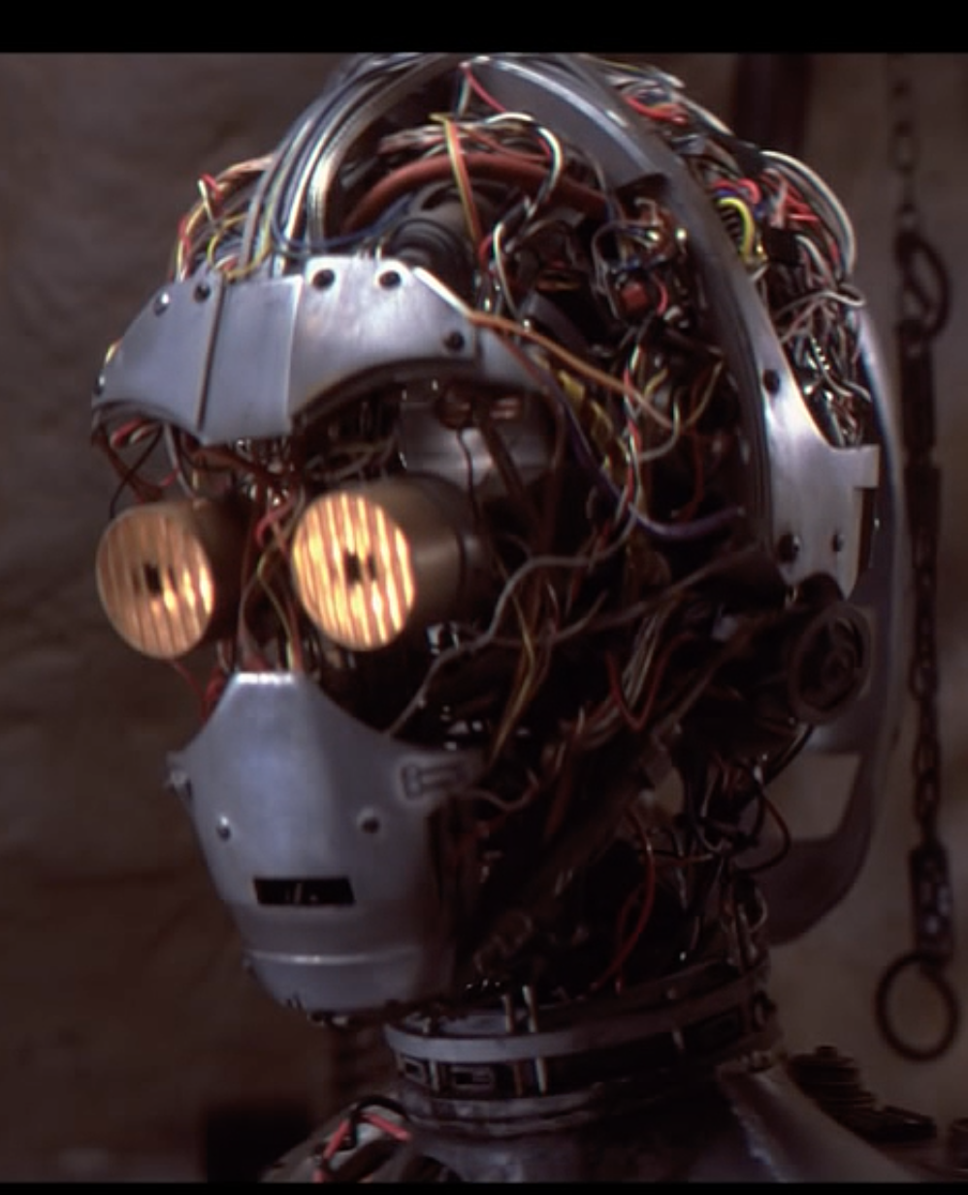
Inferiority of AI: How droids are portrayed
Robots are self-aware and have some capacity for self-preservation
Sentient life can be built by 9 year old in slave conditions
Societal expectation of abuse (Pit Droids)
[1]
Notes:
Robots are depicted as being self-aware and concerned about their appearance (C-3PO, pictured, not only recognizes who he is when he boots up, but also recognizes his own nakedness and is ashamed). C-3PO also demonstrates a level of self-preservation when Anakin mentions that he’ll tell his mom not to sell him, getting concerned about being sold away. This depicts robots as being reasonably sentient beings.
This brings up another point - given that C-3PO is a self aware, sentient lifeform, the creation of an intelligence is so simple a 9 year old slave boy on a desert planet was able to make one that ultimately outlives him. This creates the implication that such robotic life can be built easily across the galaxy on a whim
Another portrayal of droids in the movie is that it is almost expected that they will be abused. Pit Droids are a notable example of this, where they can be seen getting lifted up by their necks, punched, or even fed into pod racing engines. Not even the Jedi bat an eye at any of this, making it implied that this is a commonality across the Republic.
Image from 39.01 into the movie

Slide 8
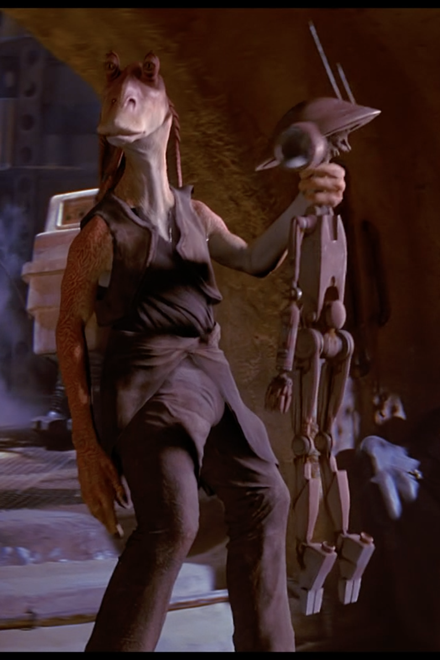
Inferiority of AI: Implications to AI
Lower than Slave Labor
Inferior to biological beings (Gungan army defeats droids)
Only robot recognized for service is non-human
[1]
Notes:
So what are the implications for how this movie portrays robotics?
It’s that AI is lower than slave labor. Watto, the businessman that owns Anakin and his mother, has plenty of droids in the back room, but he opts to sell them instead and have his slaves do work for him. Many jobs are still done by humans or other biological species, such as Gungans, including jobs easily replaced by AI such as waiters, pilots, navigators, and mechanics. The only positions shown taken by a droid are by the pit droids who fix up pod racers, though they do so alongside other biological beings. This is an incredibly dangerous job, yet it seems that people are still reluctant to be serviced by droids.
Throughout this movie there is a strong trend towards the notion that artificial intelligence is inferior to biological beings. The biggest example of this is in the climactic battle at the end, where the Gungan army, made up of Jar-Jar’s people, successfully and dramatically defeats a droid army that is both larger and far better equipped than them. Though they are described as being “primitive” and primarily using slings and catapults, they were able to hold off the droid army until more humans destroyed the droid command center. This is a long-running theme in the film, where most droids in the film are presented as being on the “bad side”, the ones opposing the success of the (almost entirely biological) heroes.
To supplement this, there is only one robot that is recognized at all throughout this film - R2D2. The only non-humanoid robot is the only one to be commended for valor, going out and fixing the escape craft while attempting to run the blockade. R2D2 is different in that it is very clearly a robot - it is the only one in the film to not be humanoid and to not speak, instead emitting beeps and whistles. This makes it almost visibly inferior, as it cannot challenge humans in many tasks and can only take commands, not give them. If anything, the recognition of R2D2 above any other robots further support the classism expressed against robots by the society in this film
Photo from 1:57:48

Slide 9
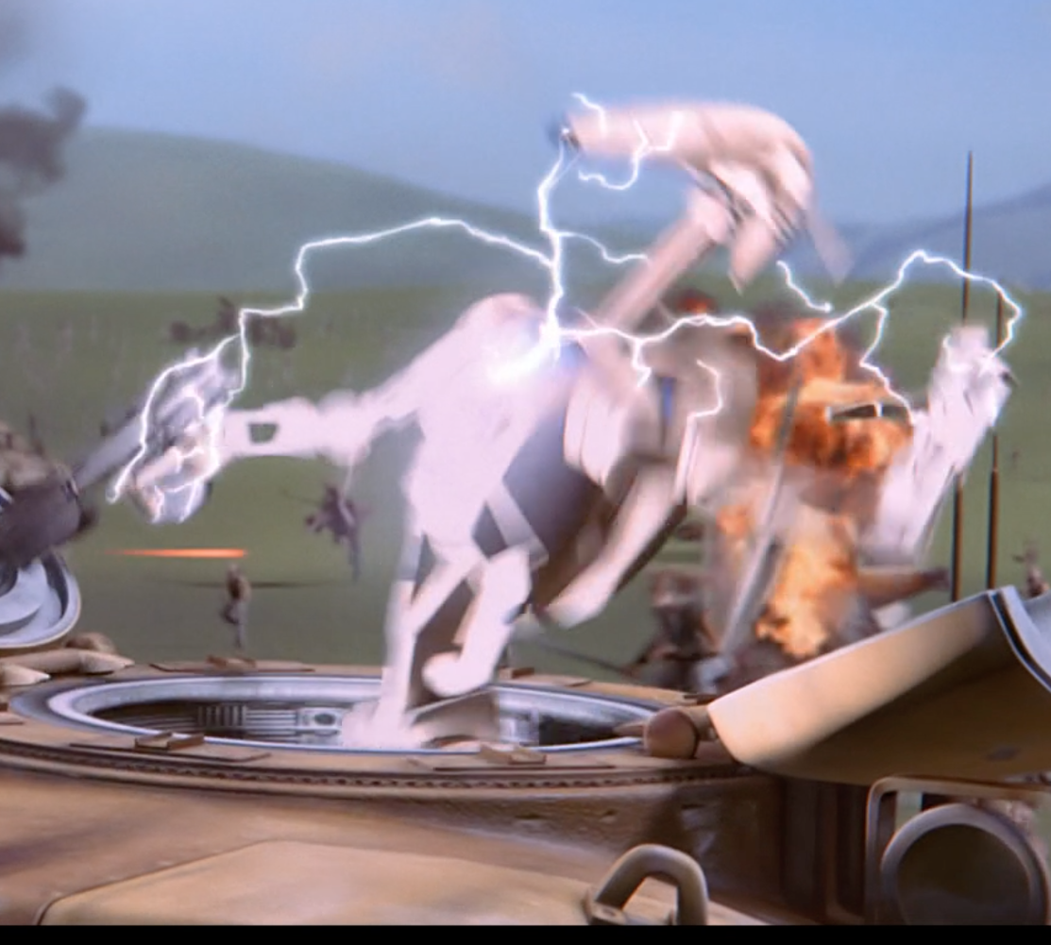
Conclusion
Summary
Technologies
Effects on Filmography
Conclusions
Importance of Redundancy
Inferiority of Artificial Intelligence
[1]

Slide 10
References
[1] Watch Star Wars: The Phantom Menace (1999) online - Amazon Video. (2017). Amazon.com. Retrieved 27 April 2017, from https://www.amazon.com/Star-Wars-Phantom-Liam-Neeson/dp/B00VF18WWG/ref=sr_1_2?ie=UTF8&qid=1491774128&sr=8-2&keywords=phantom+menace
[2] Kimura, H., Asano, A., Fujishiro, I., Nakatani, A., & Watanabe, H. (2011, August). True 3D display. In ACM SIGGRAPH 2011 Emerging Technologies (p. 20). ACM.
[3] Wireless patrol [Image]. 1923, Victoria Police Museum. Retrieved April 28, 2017 from http://inthelineofduty.com.au/timeline.asp?iID=182
[4] A Legacy of Innovation: Timeline of Motorola history since 1928. Motorola Retrieved April 28, 2017, from https://www.motorolasolutions.com/en_us/about/company-overview/history/timeline.html#1940
[5] Sagona-Stophel, K. Bitcoin 101 How to get started with the new trend in virtual currencies. WHITE PAPER. Thomson Reuters
[6] Honan, M. (2013, August). Remember the Apple Newton’s Prophetic Failure and Lasting Impact. Wired. Retrieved April 2017
[7] Altman, L. (2002, January 18) Arne H. W. Larsson, 86; Had First Internal Pacemaker. The New York Times. Retrieved April 2017
[8] Cameron Gulbransen Kids Transportation Safety Act of 2007, Pub. L. 110–189 122 STAT. 639
[9] Lucas, G. (Director). (2014, April 5). The Beginning: Making Star Wars: Episode I The Phantom Menace (Full Version) [Video file]. Retrieved April 28, 2017, from https://www.youtube.com/watch?v=da8s9m4zEpo
[10] In a First, 'Phantom Menace' to Be Screened in Digital (1999) LA Times Retrieved April 28, 2017, from http://articles.latimes.com/1999/jun/04/business/fi-44024
[11] De Lange, S. (2014, December 19) STAR WARS‘ FIRST DAYS OF SHOOTING, PART 2: THE PREQUEL TRILOGY. Lucasfilm Ltd. Retrieved April 28, 2017, from http://www.starwars.com/news/star-wars-first-days-of-shooting-part-2-the-prequel-trilogy

